Slide 1
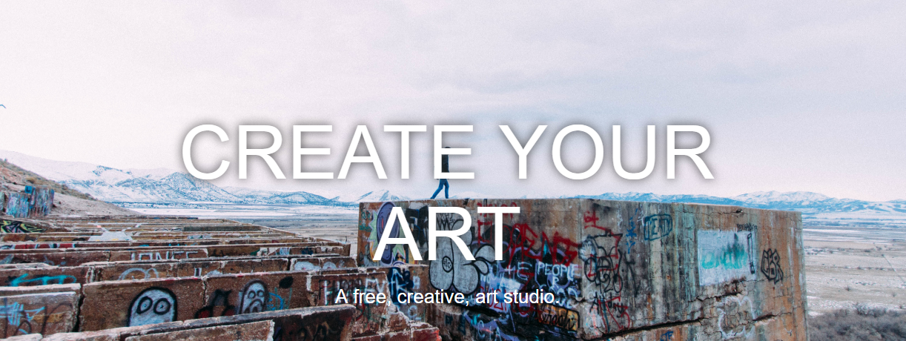
組員：楊慧郁、邱繼寬、梁家瑋
劉家維、李逸菘、邱柏勛

Slide 2
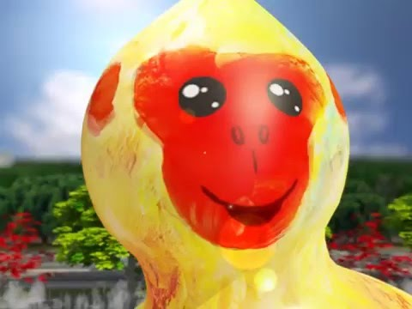
IDEA

Slide 3
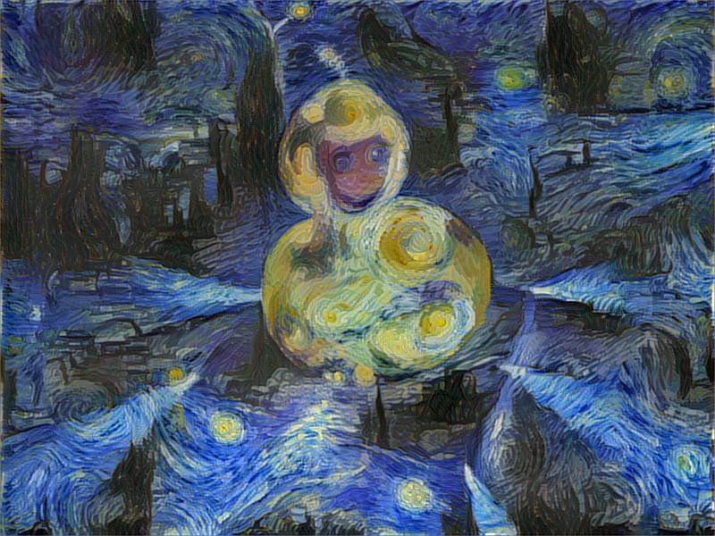
IDEA
福祿猴+梵谷《星空》
Neural Art
畫作分析！
This is not CNN, this is CNN

Slide 4

不是專業背景?
用哪些演算法?
要使用什麼工具?
如何分類畫作?

Slide 5
Time

Slide 6

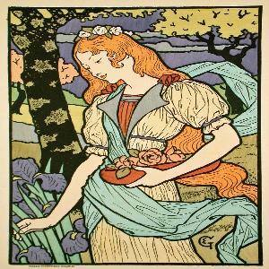


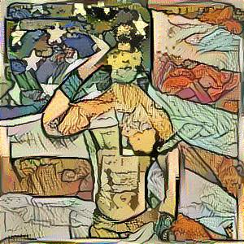
Our work
choose one painting
upload one photo
ETL
Analysis
Deep Learning!
+
Text mining
+
Kmeans
Color
Style
Magic!
Scene

Slide 7
WEB Demo

Slide 8












Architecture
Visualization
Analysis
ETL

Slide 9
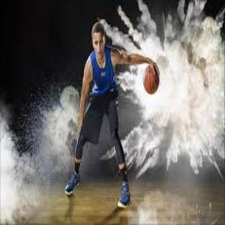
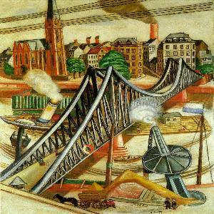
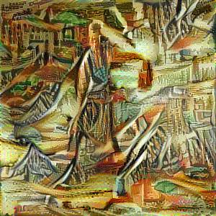


Timeline
Analysis
ETL
Transform
Load
text mining
Create Art!
Scene
Color
Style
Extract
Neural Art

Slide 10
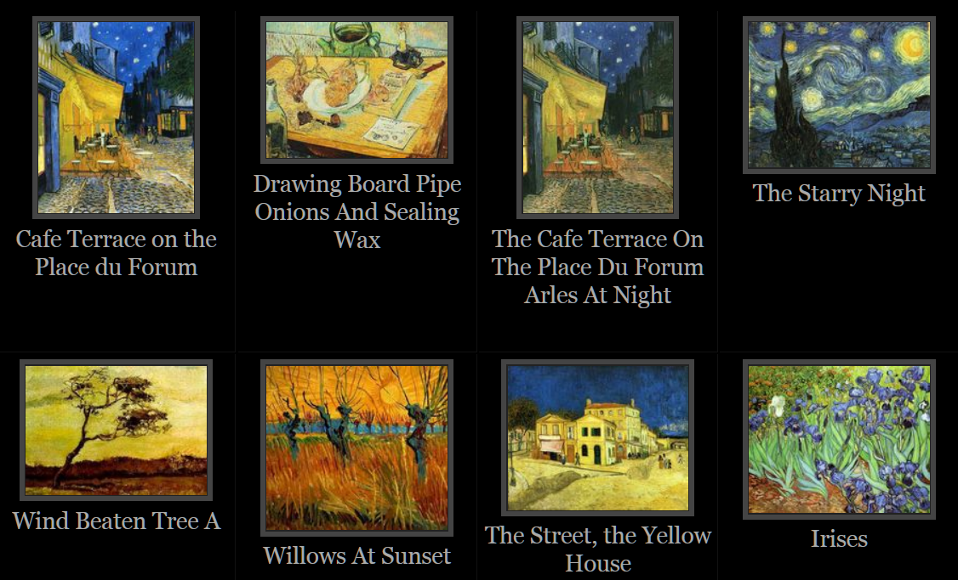
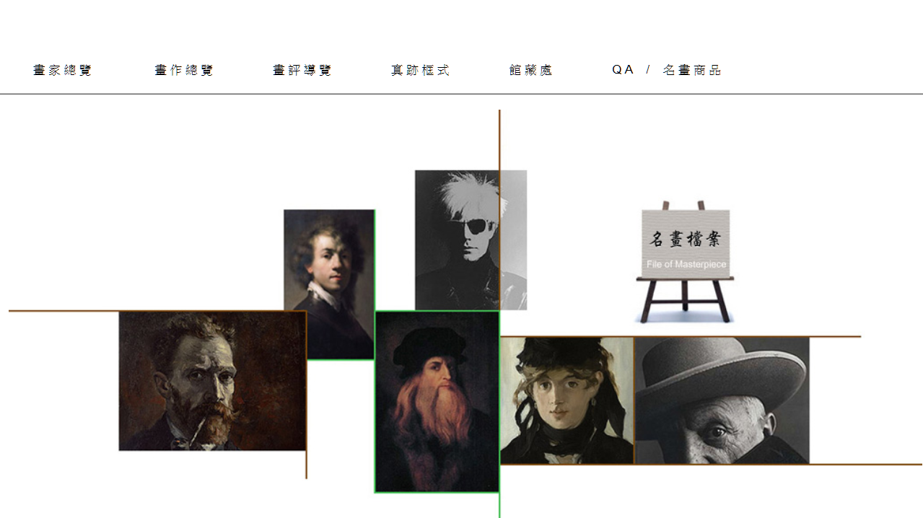
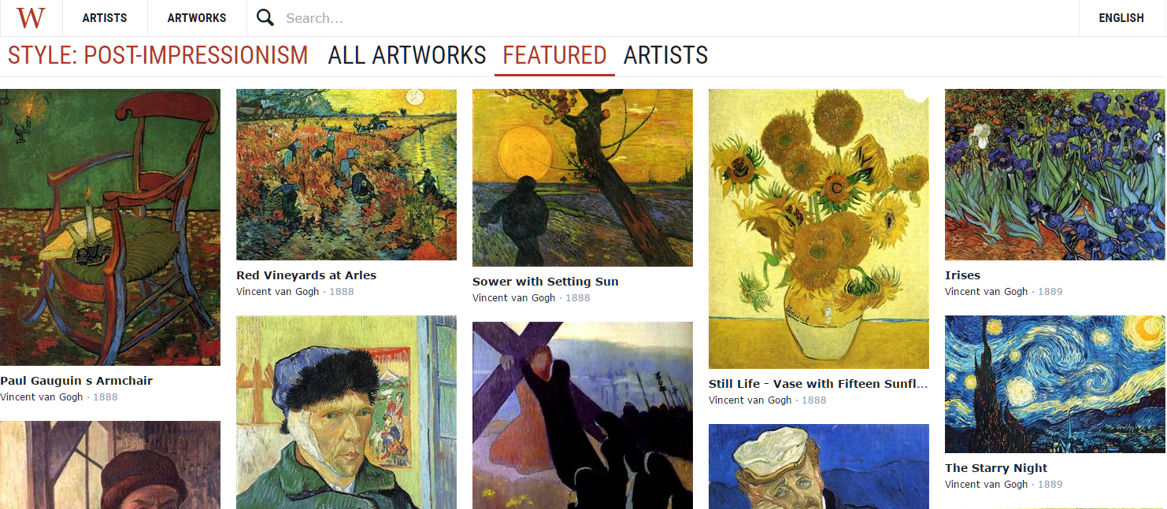
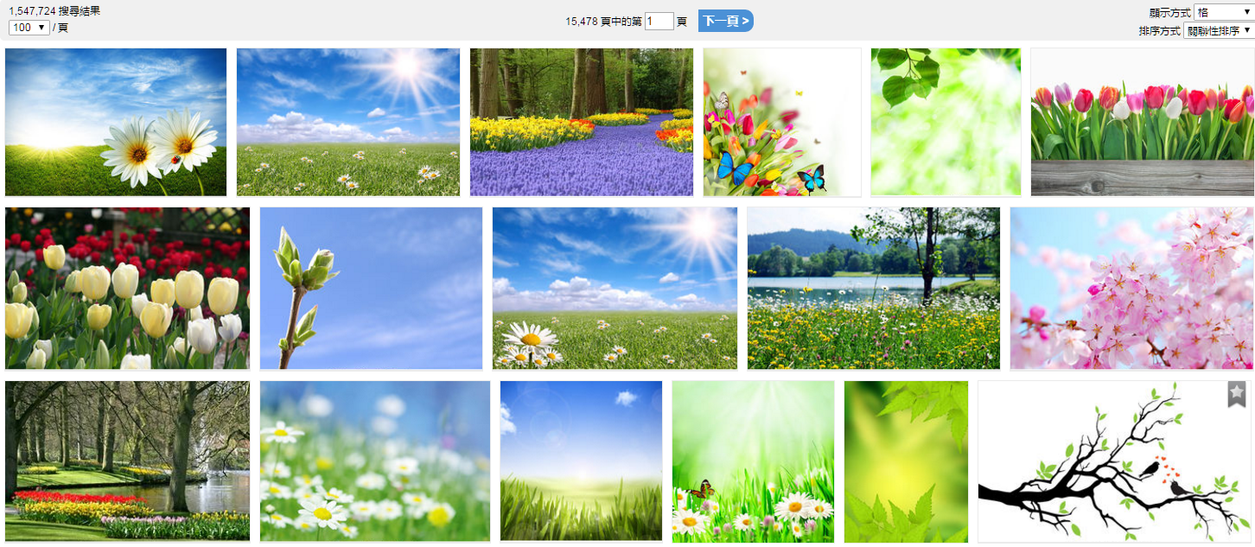
Data source
Vincent : 8,000 筆
名畫檔案 : 12,000筆
Wikiart : 12,000筆
CanStock : 15,000筆

Slide 11
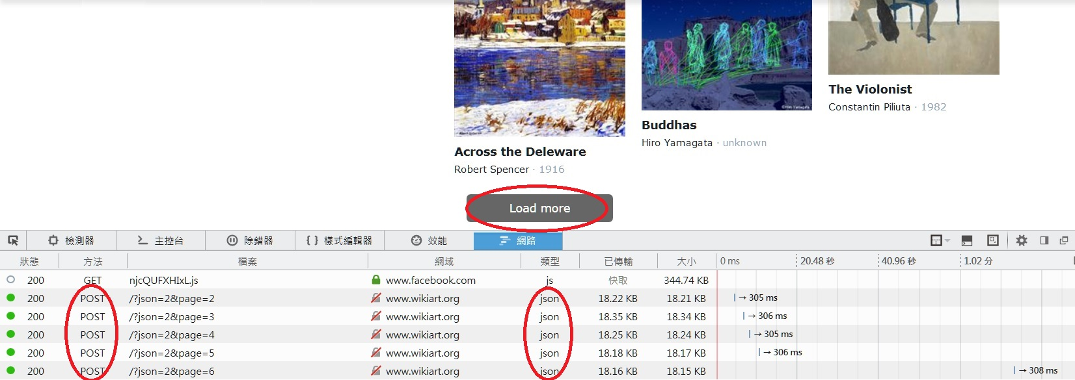
Extract
Transform
Load
Python套件
Requests、BeautifulSoup、Shutil
painting
photo
Requests.post(url , data = playload )
requests.json()
Start
Web Crawler
article

Slide 12
Extract
Transform
Load
Check pictures duplicated or damaged
Remove damaged pictures
Remove the same pictures
Check pictures has description
Regular Expression
Resize images

Slide 13
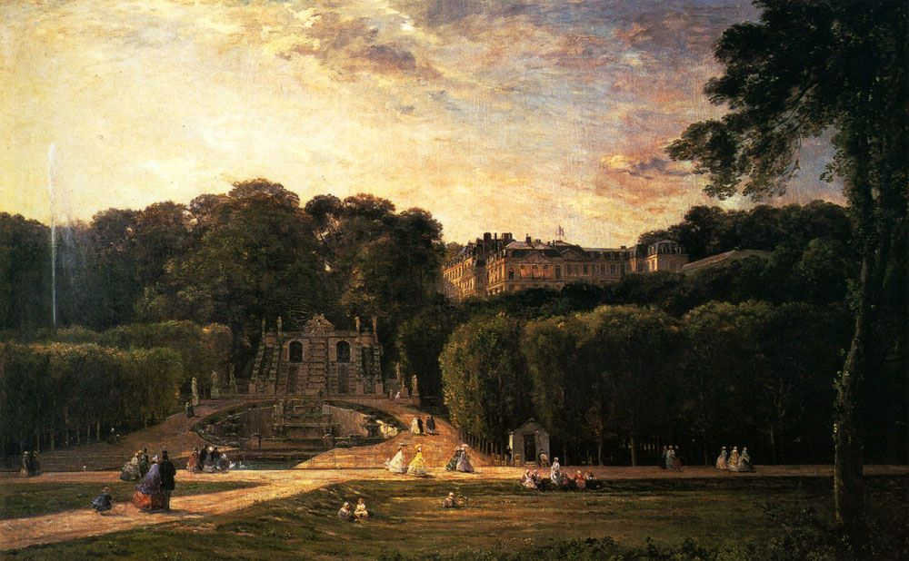

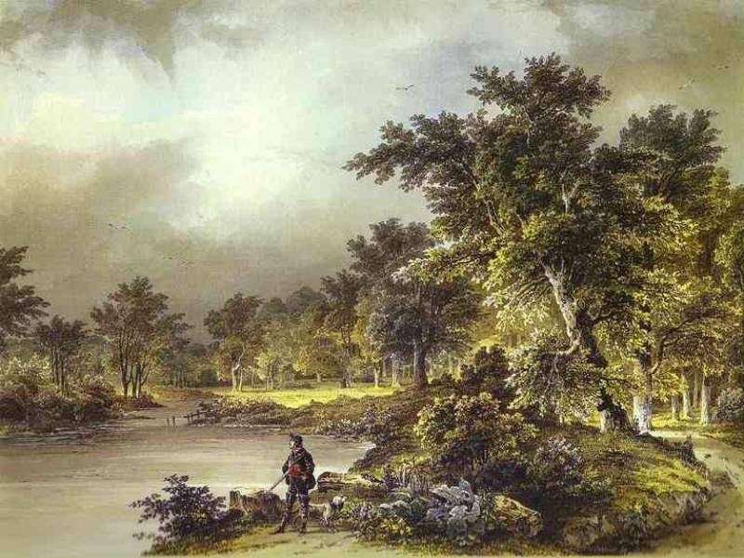

origin
resize

Slide 14

Extract
Transform
Load
Why we use MongoDB ?
Data is a JSON file
Schema – Free
Update database
Collection.update( {"pid" : pid} , { "$set" : { "HSV" : HSV }} )

Slide 15

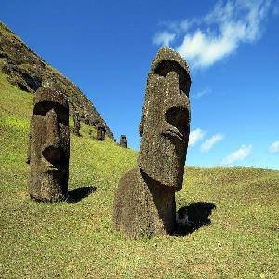
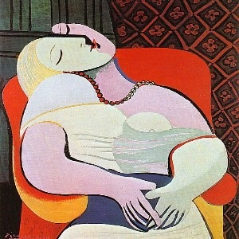
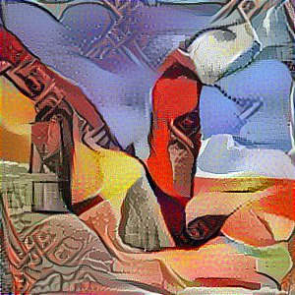
Timeline
Analysis
ETL
Transform
Load
Text Mining
Create Art!
Scene
Color
Style
Extract
Neural Art

Slide 16
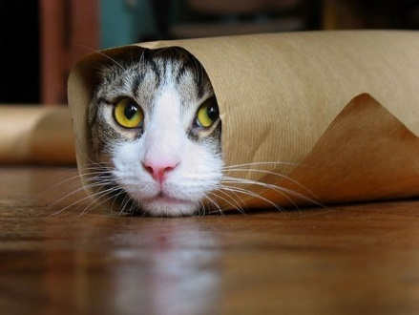


Purpose of text mining
Tools
Ngram
TF-IDF
Word2vec
To match the result of content analysis
Raise the probability of correct prediction
Image analysis
Cat
Cat
Text
mining
Painting description
Cat
Cat

Slide 17

Purpose of text mining
Tools
Ngram
TF-IDF
Word2vec
Gensim-lsi
Ngram
Word2vec
Article clustering
Dictionary
TF-IDF
Key word
Similar words

Slide 18
Purpose of text mining
Tools
Ngram
TF-IDF
Word2vec
Intro
聖母
藝術
聖尼古拉
建築物
三個
透視
傳說
生在
聖母馬利亞
安基利柯
聖告圖
P(w2) unigram
P(w2|w1) bigram
Compare the probability
今/天/天/氣/真/好
今天/天天/天氣/氣真/真好
P(天|今)>P(天)

Slide 19


Purpose of text mining
Tools
Ngram
TF-IDF
Word2vec
Construct dictionary
Biggest reason to apply Ngram is...?
jieba is not good enough
and our topic is unique

Slide 20
Purpose of text mining
Tools
Ngram
TF-IDF
Word2vec
TF: specified word occurred how many times in this article
IDF: how many articles occurred this word
IDF=log(d)-log(t)
d:total number of articles
t:number of articles occurred this word
Unfortunately, result is bad
Key word
戰神,美酒,美神
波蘭,馬鞍,波托
利薩,姐夫,達維
氣質,達維,戰士
效忠,造神,拿破崙
其上,馬爾斯,芙
基督教,尼祿,塞內卡
特洛伊,海倫,帕里斯

Slide 21

Purpose of text mining
Tools
Ngram
TF-IDF
Word2vec
Why?
Because the bad result of TF-IDF
Use TF-IDF result to expand mapping content
Word2vec
A tool
to transfer word
to vector

Slide 22
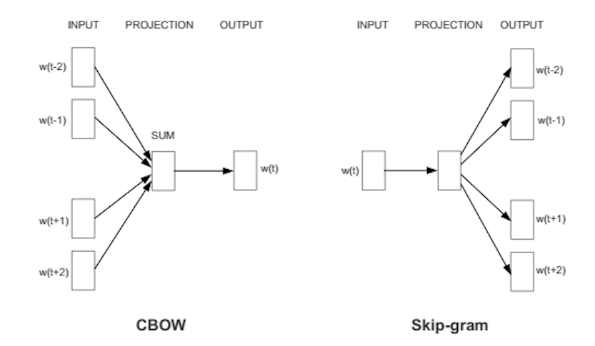

Purpose of text mining
Tools
Ngram
TF-IDF
Word2vec
Intro
CBOW v.s. Skip gram
CBOW: from context of input infer which words would occur under the context
Skip gram: infer context by given word

Slide 23
Purpose of text mining
Tools
Ngram
TF-IDF
Word2vec
Eventually, the result is still bad…
The biggest problem of bad output is…
Only 4000 art comments
Solution:
Collect more articles as possible
Try English article description and comment

Slide 24
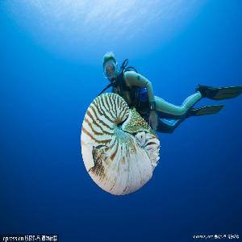
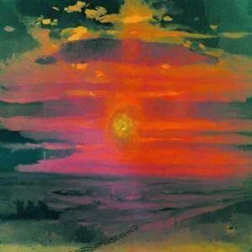
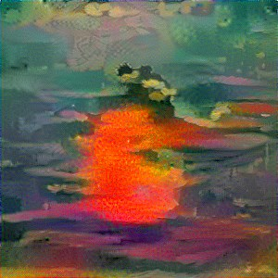

Timeline
Analysis
ETL
Transform
Load
text mining
Create Art!
Scene
Color
Style
Extract
Neural Art

Slide 25
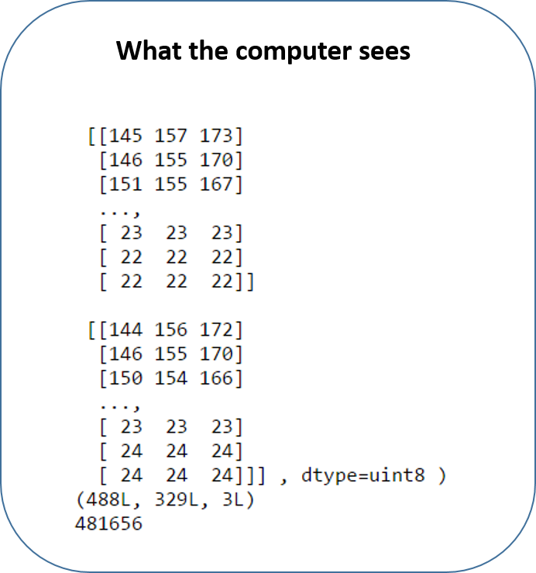
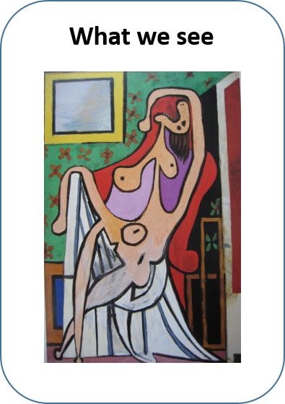
Computer Vision
Color Model RGB
K-Means
Color Model HSV
Distance
Image to Matrix
Get the useful information

Slide 26
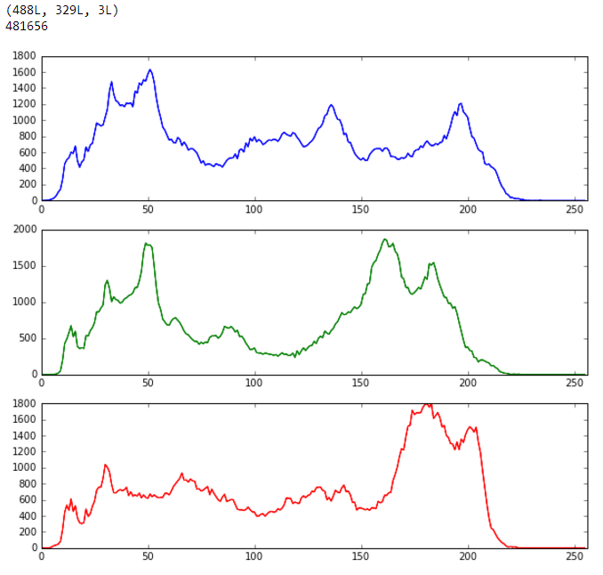
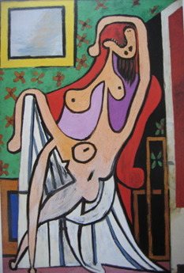
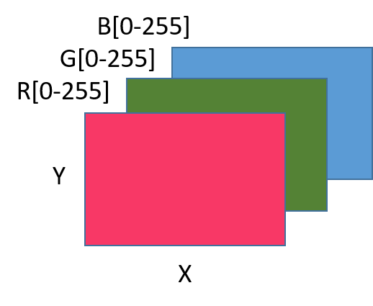
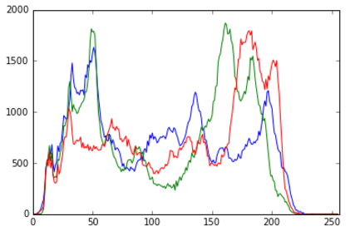
Computer Vision
Color Model RGB
K-Means
Color Model HSV
Distance
Lots of information
3D for RGB

Slide 27
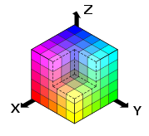
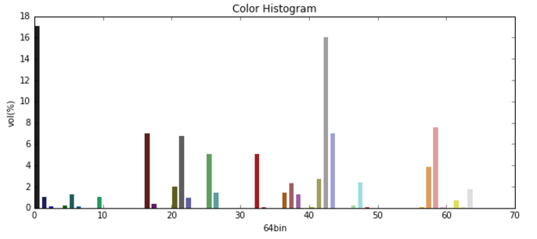



Computer Vision
Color Model RGB
K-Means
Color Model HSV
Distance
RGB (Red-Green-Blue )
Additive Primary Colors
Hard to visualize the effect of adding values
Each of pixel
(129, 191, 180)
(172, 185, 204)
(184, 154, 195)

Slide 28
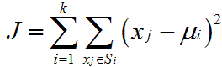


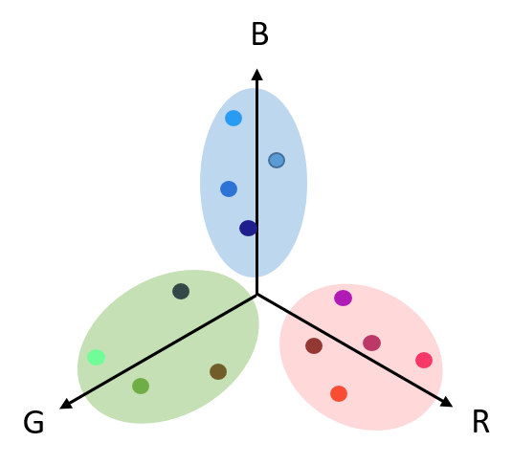
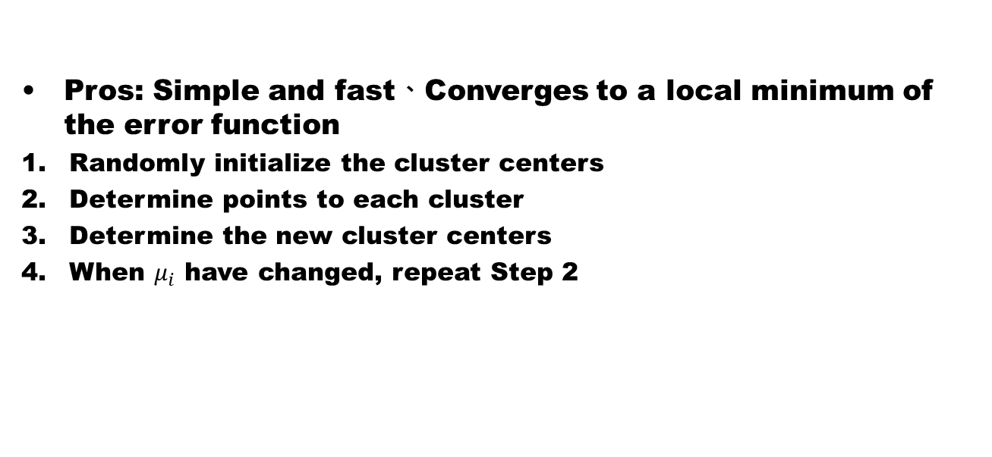
Computer Vision
Color Model RGB
K-Means
Color Model HSV
Distance
Pros: Simple and fast、Converges to a local minimum of the error function
Randomly initialize the cluster centers
Determine points to each cluster
Determine the new cluster centers
When $μ_{i}$ have changed, repeat Step 2
B
1
B
2
B
3
B
G
R
G
R
G
R
G
R

Slide 29
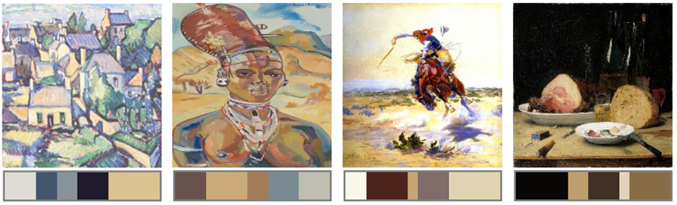


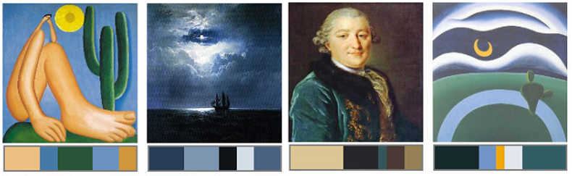

Computer Vision
Color Model RGB
K-Means
Color Model HSV
Distance
RGB
(224, 224, 160)
HSV Color Model & Similarity
RGB
(32, 96, 96)

Slide 30
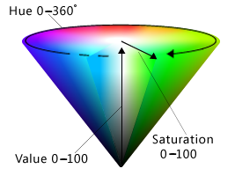
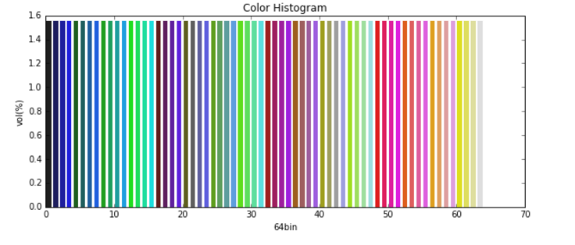
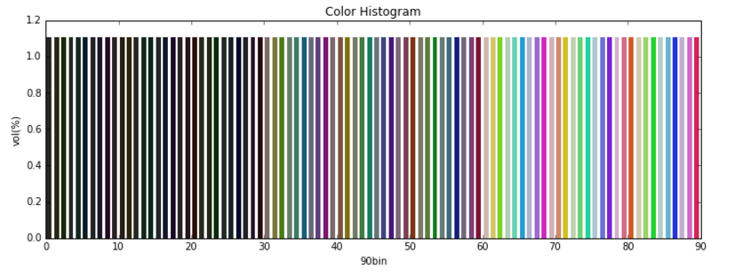
Computer Vision
Color Model RGB
K-Means
Color Model HSV
Distance
HSV ( Hue-Saturation-Value )
Hues can easily be imagined
Often used in computer vision
RGB
HSV

Slide 31

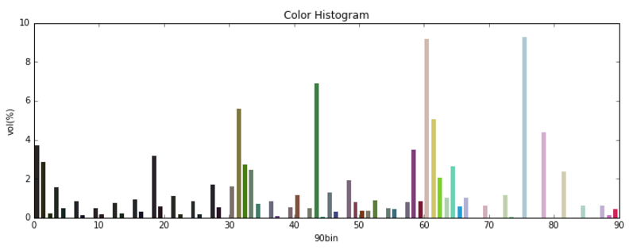
Computer Vision
Color Model RGB
K-Means
Color Model HSV
Distance
Each of pixel
Each of pixel
(129, 191, 180)
(113, 0.32, 0.62)
(172, 185, 204)
(144, 0.23, 0.73)
(184, 154, 195)
(189, 0.25, 0.68)
RGB
HSV

Slide 32
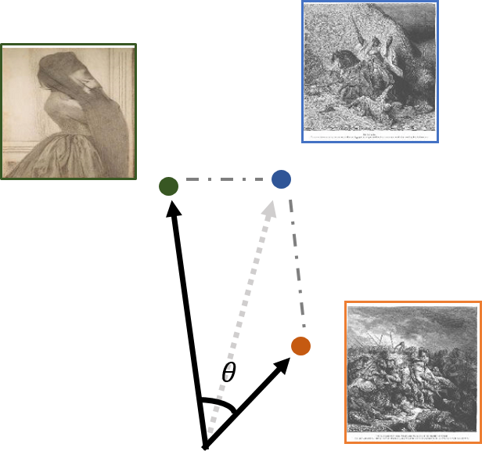
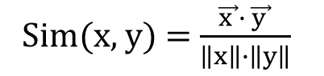
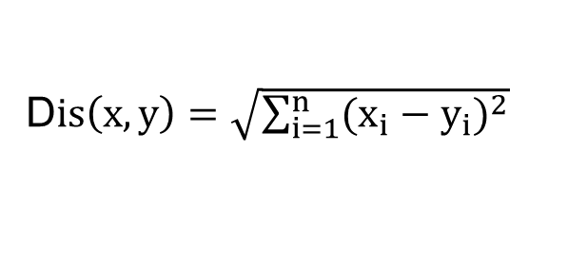
Computer Vision
Color Model RGB
K-Means
Color Model HSV
Distance
Euclidean distance
Cosine Similarity
D$is\left(x,y\right)=\sqrt{\sum_{i=1}^{n}{{(x_{i}−y_{i})}^{2}}}$
Sim(x, y) = $\frac{\vec{x }∙ \vec{y }}{\left\|x\right\|∙\left\|y\right\|}$

Slide 33
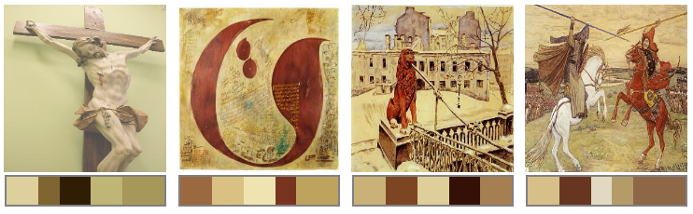

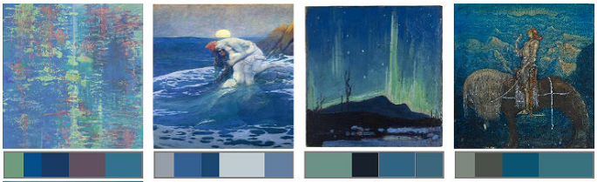

Computer Vision
Color Model RGB
K-Means
Color Model HSV
Distance
(29, 0.40, 0.77)
(132, 0.33, 0.37)

Slide 34
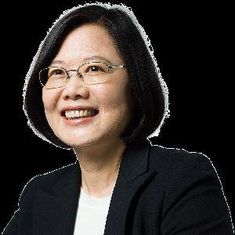
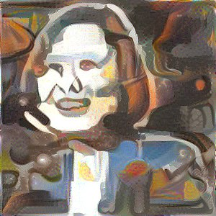
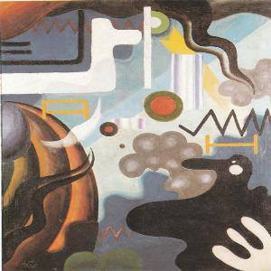

Timeline
Analysis
ETL
Transform
Load
text mining
Create Art!
Scene
Color
Style
Extract
Neural Art
(Training Model)
Notes:
接著我們請浩克易崧同學來為我們介紹如何來分辨畫風

Slide 35
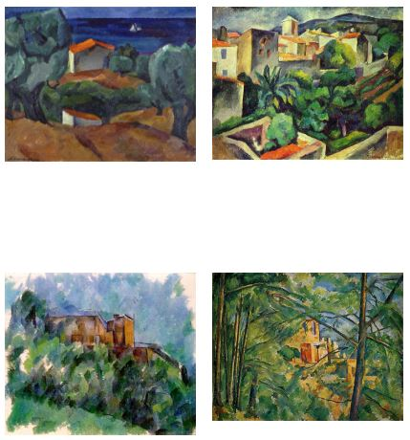
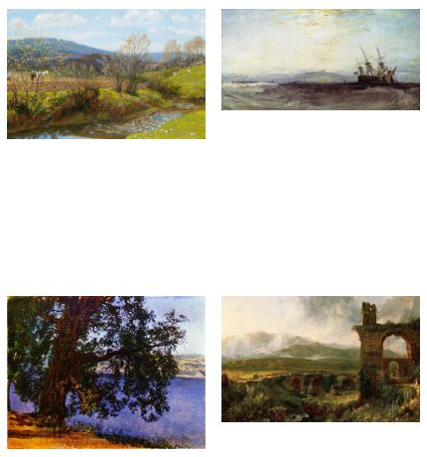
畫風辨識
監督式
學習
演算法
工具
結果與困難
改善方向

Slide 36
畫風辨識
監督式學習
演算法
工具
結果與困難
改善方向
最常見的機器學習問題
Label，網站上分類的畫作標籤
Data，80% training set
20% testing set

Slide 37

畫風辨識
監督式學習
演算法
工具
結果與困難
改善方向
類神經網路：
模擬人腦結構，經過學習後，得到model，可以從輸入資料中預測結果

Slide 38


畫風辨識
監督式學習
演算法
工具
結果與困難
改善方向
CNN：
與傳統類神經網路相比，CNN更適合用於圖像中

Slide 39


畫風辨識
監督式學習
演算法
工具
結果與困難
改善方向
ReLU (傳遞函數)
比起傳統Sigmoid，訓練較快、計算更簡單
優化算法：Rmsprop

Slide 40


畫風辨識
監督式學習
演算法
工具
結果與困難
改善方向
程式語言：python
Library：tensorflow， google開源的機器學習框架
想做出deep learning的model，但是不懂複雜的數學?

Slide 41

畫風辨識
監督式學習
演算法
工具
結果與困難
改善方向
Cpu-2days
Gpu-40 mins

Slide 42


畫風辨識
監督式學習
演算法
工具
結果與困難
改善方向
畫風：23類
畫風：8類
硬體，training過程，電腦容易當機
圖片大小影響training準確度和速度
參數調整需要不斷重複training model

Slide 43
畫風辨識
監督式學習
演算法
工具
結果與困難
改善方向
圖片放大 (需要先改善硬體)
預先萃取跟畫風相關的 feature，在做 training
增加模型複雜度、程式參數調整優化

Slide 44




Timeline
Analysis
ETL
Transform
Load
text mining
Create Art!
Scene
Color
Style
Extract
Neural Art
(VGG19 Model)

Slide 45


Model selection
Feature extract
Image similarity
A pre-trained model called vgg19
CNN structure
Faster than other structure like googlenet Retain same accuracy

Slide 46




Model selection
Feature extract
Image similarity
Save the features
Decide which layer
A giant matrix
Define what kinds of picture you want
Clear brushwork people
Clear brushwork scenery
Blurry brushwork people
Blurry brushwork scenery

Slide 47










Model selection
Feature extract
Image similarity
Each image compares the distance with defined category
All of the images should be the same size

Slide 48




Timeline
Analysis
ETL
Transform
Load
text mining
Create Art!
Scene
Color
Style
Extract
Neural Art

Slide 49
Image Recognition
Cases
Limitations
Features Extraction
Result
Model: inception-v3
classify images into 1000 classes in Python
achieve reasonable performance on hard visual recognition tasks

Slide 50


Image Recognition
Cases
Limitations
Features Extraction
Result
Case1: Simple test

Slide 51

Image Recognition
Cases
Limitations
Features Extraction
Result
Case2: close shot

Slide 52


Image Recognition
Cases
Limitations
Features Extraction
Result
Case2: long shot

Slide 53



Image Recognition
Cases
Limitations
Features Extraction
Result
Case3: shape

Slide 54




Image Recognition
Cases
Limitations
Features Extraction
Result
Case4: Art Style

Slide 55
Image Recognition
Cases
Limitations
Features Extraction
Result
close shot & long shot
shape
Art style
when it’s not in 1000 classes
set threshold: score >= 0.5
➔ 30% data left

Slide 56
Image Recognition
Cases
Limitations
Features Extraction
Result
Solution 1: train the model
Time
Data volumes
Solution 2: extract features & cluster

Slide 57

Image Recognition
Cases
Limitations
Features Extraction
Result
Use 4096-D activations
as image features

Slide 58








Image Recognition
Cases
Limitations
Features Extraction
Result
Portrait
Arch
Building
Round
Street
Ship & water
Nude
Dress

Slide 59

Timeline
Create Art!
Neural Art
ETL
Extract
Transform
Load
Analysis
Text Mining
Color
Style
Scene

Slide 60








Content
Style
How To Drawing
Start Drawing
Content & Style
Human
Canvas
Final
Computer
Ref:
A Neural Algorithm of Artistic Style ,2015
Leon A. Gatys, Alexander S. Ecker, Matthias Bethge

Slide 61










Content
Style
How To Drawing
Start Drawing
Canvas
Content
CNN
Filter Response
Least squares
$$L_{content}(Canvas+Content)$$

Slide 62











Content
Style
How To Drawing
Start Drawing
Canvas
Style
CNN
Filter Response
Gram Matrix
G
Least squares
G

Slide 63






Content
Style
How To Drawing
Start Drawing
CNN
Filter Response
$$L_{content}(Canvas+Content)$$
Gram Matrix
$$L_{total}={αL}_{content}+{βL}_{style}$$
Conv1_1
Conv2_1
Conv3_1
Conv4_1
Conv5_1
Conv4_2
$$x=x− η \frac{∂L_{total}}{∂x}$$

Slide 64







Summary
ETL
Extract
Transform
Load
Analysis
text mining
Color
Style
Scene
Create Art!
Neural Art

Slide 65

Future Work
Train model
Create member upload area
Merge picture immediately
Neural doodle

Slide 66
Neural Art Demo

Slide 67
References
Thesis
Sergey Karayev, Matthew Trentacoste, Helen Han, Aseem Agarwala, Trevor Darrell, Aaron Hertzmann, Holger Winnemoeller (2014). Recognizing Image Style BMVC
Leon A. Gatys, Alexander S. Ecker, Matthias Bethge (2015). A Neural Algorithm of Artistic Style arXiv
Websites
Wikipedia
Slides
Some slides of this lectures are courtesy of prof F. Li, prof S. Lazebnik, and various other lecturers EECS 442 – Computer vision
Aaron Bobick (slides by Tucker Hermans) CS 4495 Computer Vision Segmentation

Slide 68
Q & A

Slide 69
Thank you

